Slide 1

UK Regulators
Network
Reflections on responding to the impact of Covid and the way forward: A regulatory perspective
A UKRN event
17 June 2021

Slide 2
Objectives
Learning This event provides the opportunity to take a step back and reflect collectively on the experiences and learnings of the last 15 months, and to look ahead to consider what this means for the future.
Knowledge sharing UKRN members share their experiences of the impact of the pandemic and how we have responded as regulators.
Collaboration These presentations set the scene for discussion as we share our learning, identify challenges and start to examine ambitions for the future.

Slide 3
Introductory remarks from our CEO Jonathan Brearley
The pandemic has changed lives and the economy in ways we would not have thought possible. It has touched each and every one of us personally.
I want to start by acknowledging all those who have worked tirelessly throughout the pandemic, especially those in frontline engineering roles and those who have worked to get support to those most in need and in vulnerable circumstances.
Our collective response as regulators, working with government and industry, ensured decisions were taken quickly so that the essential services we rely on continued to be delivered throughout this time. We can all be incredibly proud of the important role we have played in the national response to this crisis.
‘Collaboration with purpose’ is the lifeblood of UKRN. I am extremely pleased and encouraged by how the UKRN has continued to support this crucial engagement through our many networks during the pandemic.
Whilst it is important we reflect on some of the positives we have seen during this period, including the enhanced collaboration and faster decision making we have seen across government, regulators and industry – it is also timely to reflect on what lays ahead of us in our regulated sectors and any enduring changes we might need.

Slide 4
Opening remarks (cont)
The year ahead
As a community of regulators we have a very big year ahead of us and are incredibly well placed to play a key role in initiatives to support the economic recovery, including in energy where we are focussed on doing all we can to enable a green recovery and provide international leadership as part of this year’s COP 26 conference.
But according to a study by Stepchange (Stormy weather: Covid and Debt, Jan 2021 Covid-19 & Debt Impact Report. January 2021. StepChange ) of the 11.3 million people who have experienced a fall in income since the start of the pandemic, 1 in 5 has fallen behind on at least one household bill; most often council tax, utilities or rent.
We therefore have a vital role to work with our regulated sectors, as well as with each other, to continue to support consumers throughout the pandemic and deal with the economic and social issues it has created.

Slide 5
Agenda
1. Welcome and introductions Opening remarks from Jonathan Brearley our UKRN CEO and Ofgem CEO, setting out the objectives and agenda for the session.
2. The impact of Covid External context FCA: Margaret Watmough Financial Lives research presentation on financial impact of Covid on consumers United Utilities: Louise Beardmore Customer Service and People Director – impact from firm perspective and what does it mean
3. Regulatory response by sector Three presentations from regulator members on response to Covid and learnings Financial Regulation FCA: Nisha Arora Director Consumer and Retail Policy Utilities: Ofgem: Meghna Tewari Head Retail Market Policy Transport: CAA: Rob Bishton Group Director Safety and Airspace Regulation
4. Q&A / Discussion Questions/reflections on key learnings for the future – what next? General roundtable discussion.
5. Closing remarks Attricia Archer, UKRN Director to summarise with headline takeaways

Slide 6




Key emerging themes
Future focus on consumers in debt, and affordability, with the lasting impact of Covid
Retain responsiveness to industry, essential for sectors to remain competitive.
Use of data, and data driven solutions, across sectors where possible
Continue to listen, learn and adapt to consumer needs: enable innovation
These themes chime with our workplan priorities:
1. Improving outcomes for consumers in vulnerable circumstances or with additional needs
2. Adapting our regulatory approach where appropriate to support the innovation and investment necessary for economic recovery, resilience and growth
3. Strengthening joint regulatory capabilities to meet shared current and future challenges
Through our networks we will have regard to these findings and continue to work together to manage issues of customer debt and affordability, employ effective stakeholder engagement and work in a joined up and transparent way with partners including government and regulated firms.

Slide 7
Summary of reflections
Content
Context
Across the sectors
Consumer organisation perspectives
Looking forward
1. Context
Those who were badly off pre pandemic, ie those with less financial resilience, have been hardest hit. Young people, BAME and women were also impacted disproportionately in the pocket.
The impact also varied across the UK, with some areas having more lockdowns, and those with higher proportions of lower paid workers from harder hit sectors suffering more – for example in the North West. Covid has exacerbated levels of deprivation and impacted demand on services.
It will be important to maintain a more segmented view and not apply a one size fits all approach.

Slide 8
2. Across the sectors
Utilities providers reported increased demand for services, such as water, as customers stayed at home. There was a shift in customer needs and consumption, including for the newly vulnerable and for those shielding. The shift in demand highlighted the importance of customer data and joining up with other data sources to inform responsive regulation. It was also important to join up communication across the supply chain at this time to ensure customer demand was met: understanding the customer journey remains key.
Markets have shifted and will take time to recover and will most likely have changed forever: this will be mirrored in the consumer journey which will continue to evolve.
Conversely, in transport sectors, demand dropped dramatically from the 300m people previously travelling through airspace. With mass cancellations, industry faced a requirement to refund alongside an absence of new business, challenging industry resilience. Sector looked to regulator to uphold safety and maintain consumers' interests to enable consistency and stability, sitting between government and industry. Information exchange and transparency between stakeholders was essential. The industry has become more consumer focused.
The pandemic provided some benefits in terms of meeting carbon targets and looking forward sectors will need to maintain sustainable industries.

Slide 9
(2. Cont)
In financial services regulators had to put measures in place quickly to protect consumers facing income shortfalls. It was important to balance consumer protection with ensuring the sustainability of markets. Prioritisation became even more important given stretched resources. Customer needs came to the fore and should be the primary focus of all activities.
As the situation developed there was a shift of focus from interventions to support consumers in general, towards encouraging firms to provide support tailored to individual customer circumstances and needs. For example, the self-employed have been seriously affected and are likely to find it hard to bounce back, depending on their line of business
Across sectors regulators have worked quickly to address the needs of consumers, made easier by having shared objectives. Common goals to support consumers are really important as we emerge from Covid, to be carried forward collectively where appropriate. UKRN has many common goals/strategies across markets that could use this approach, as reflected in our workplan.
And the pandemic has sparked innovation – for example water companies testing wastewater for levels of Covid to help authorities predict developing surges and spikes in the virus in regional areas, collaborating with others and sharing relevant (non-competitive) data in their sectors for the good of the country.

Slide 10
3. Consumer perspectives on work to do
UKRN members have done well. As we emerge from the depth of the crisis we need to maintain responsive regulation and engagement with stakeholders: regulators have worked quickly to support consumers at the height of the crisis. Continue to work towards a universally clear and consistent approach.
Areas for greater focus:
despite close working with Government on sectoral approaches, didn’t always align support across sectors, for example taking a holistic view of household bills across the piece.
improved data sharing so that consumers could be targeted or ask for support. Importance of data to track impact of interventions.
communicate the need and requirement for forebearance: closer working with advice agencies.
support the rebuild of household finances long term. And how do we help develop financial inclusion?

Slide 11
4. Looking forward
Key emerging themes:
Future focus on consumers in debt, and affordability, with the lasting impact of Covid.
Retain responsiveness to industry, essential for sectors to remain competitive.
Use of data, and data driven solutions, across sectors where possible
Continue to listen, learn and adapt to consumer needs: enable innovation
Regulatory interventions will continue to be needed in order to support sectors. Building on our learning these should take into account:
Responsive regulation – responding to events on the ground and understanding customer journeys.
Response from Government – enabling regulators/industry to move at pace.
Distribution analysis – there have been different impacts on different customer groups.
A joined-up approach - in responses to consumers, where appropriate.
Innovative use of data and data sharing to support understanding and implementation.
Driving firms to take a proactive approach and support innovation – inclusive design principles to deliver fair outcomes and drive culture change.
***

Slide 12
Speaker Presentations
The impact of Covid: external context
Financial Conduct Authority: Margaret Watmough Technical Specialist
Financial Lives Survey research presentation on financial impact of Covid on consumers
United Utilities: Louise Beardmore Customer Service and People Director
Impact from firm perspective and what does it mean

Slide 13

Financial Lives: the financial impact of Covid on consumers
UKRN: Covid event
17 June 2021
Margaret Watmough

Slide 14
Agenda
Surveys and reports
Consumers with characteristics of vulnerability – changes from 2017 to February 2020 to October 2020
Warning signs in early 2020 – and worsening financial situations overall due to Covid
Changes to financial position because of Covid
Credit repayments and use of payment deferrals

Slide 15
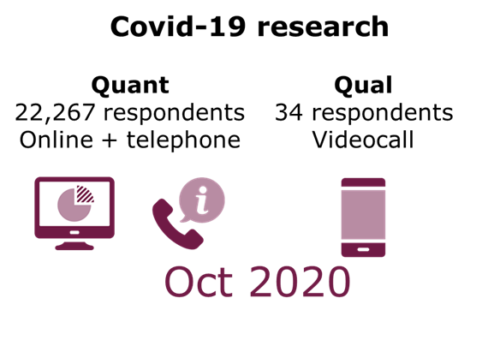


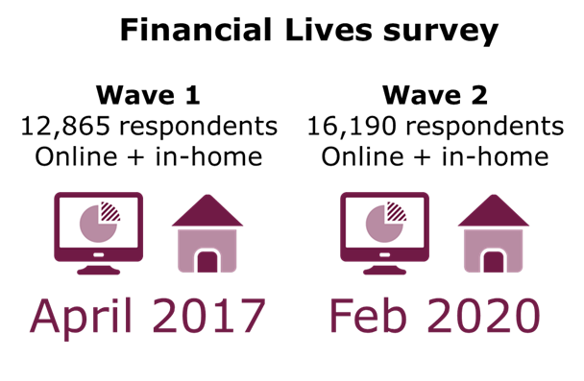
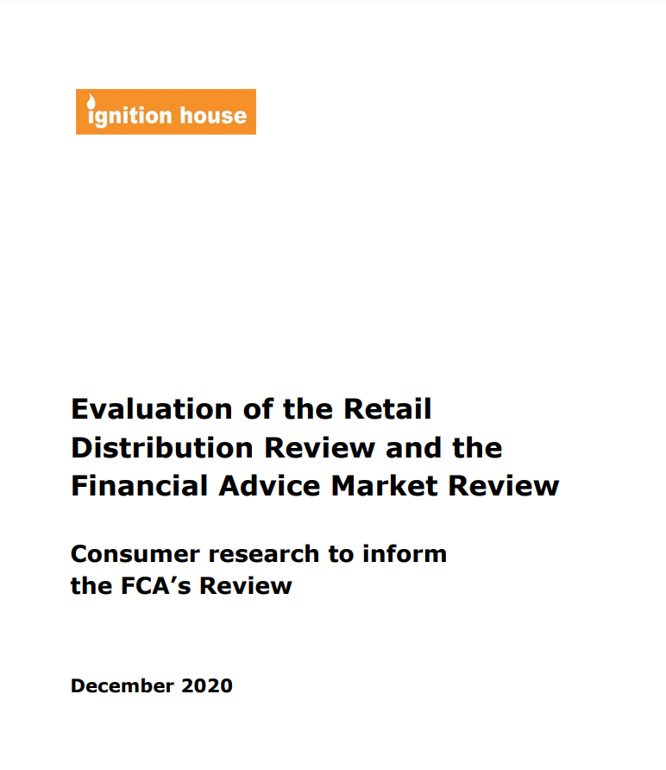




“Financial Lives survey 2020: impact of coronavirus” report and methodology
What methodology did we use for the Covid-19 research?
Random probability sampling
Digitally excluded interviewed in home
Nationally representative - excellent
Covers all retail sectors
Over 1,300 questions
Online panel using quota-based sampling and sophisticated weighted
Nationally representative – very good
Digitally excluded interviewed by phone
Focus on the impacts of Covid-19
Circa 150 questions

Slide 16
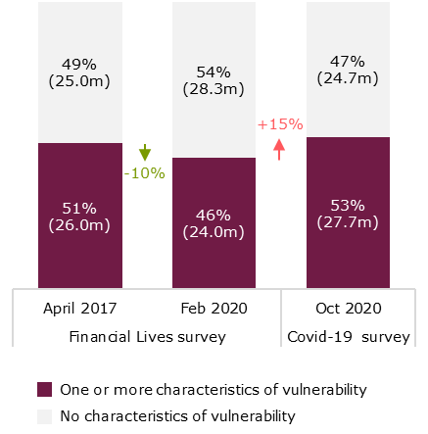
Covid-19 has reversed the downward trend in vulnerability. There are now 27.7 million adults with characteristics of vulnerability
% with characteristics of vulnerability
The largest proportional increases in vulnerability between February and October 2020 were among adults:
  Aged 18-34
  Self-employed February 2020
  With a mortgage
  BAME adults
Figure 3.1: Proportion of adults who show characteristics of vulnerability (April 2017/ Feb 2020/Oct 2020)
Source: FLS April 2017/FLS Feb 2020/Covid‑19 survey, Oct 2020 Base: All UK adults (2017:12,865/Feb 2020:16,190/Oct 2020:22,267)

Slide 17
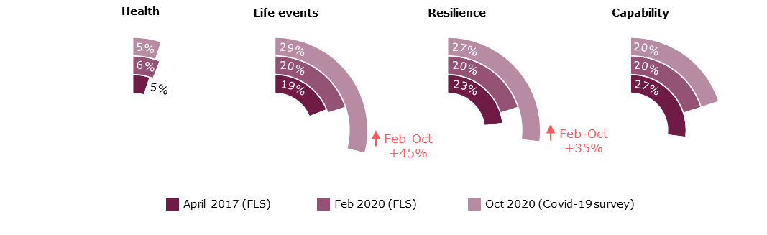
The increase in the proportion with characteristics of vulnerability is driven by negative life events (e.g. reduced hours, redundancy) and low financial resilience
Poor health: ‘have a physical or mental health condition or illness that has lasted or is expected to last 12 months or more … that reduces your ability to carry out day-to-day activities’.
The Equality Act 2010 defines disability as having a physical or mental impairment that has a substantial and long-term adverse effect on their ability to carry out normal day-to-day activities.
The EA definition of disability automatically includes people with progressive conditions such as HIV infection, cancer and multiple sclerosis, from the day of diagnosis. FLS does not specifically capture these conditions. Because FLS captures people who are disabled, but not all of those considered to be disabled under the EA, we refer to people ‘in poor health’ rather than ‘disabled.’
Figure 3.3: Proportion of adults who show characteristics of vulnerability by the four drivers (April 2017/Feb 2020/Oct 2020)
Source: FLS April 2017/FLS Feb 2020/Covid‑19 survey, Oct 2020 Base: All UK adults (2017:12,865/Feb 2020:16,190/Oct 2020:22,267)

Slide 18

Half of adults aged 65 or over have one or more characteristics of vulnerability, rising to 84% among those aged 85 or over
FCA Official
Proportion of adults who show characteristics of vulnerability by the four drivers (Feb 2020)
Poor health
Negative life events
Low financial resilience
Low capability
21%
20%
22%
76%
11%
16%
16%
41%
8%
15%
14%
33%
6%
20%
20%
20%
All UK adults
Age 65 or over
Age 75 or over
Age 85 or over
Source: Financial Lives survey 2020. Base: All UK adults (16,190)

Slide 19
Significant minorities of UK adults have characteristics of vulnerability and are telling us they are struggling, in debt and/ or not able to engage with firms as a result (Feb 2020)
Have debt (proxy for low financial resilience)
Low capability
13%
Of UK adults are over-indebted or have credit (excluding those who only transact) and have been badly affected by their debt over the last 12 months
13%
Of UK adults have low capability and have experienced difficulties dealing with finances or financial services
Equates to 6.9m adults
Equates to 6.7m adults
Recent negative life event(s)
Poor health
4%
Of UK adults have poor health and have had difficulties dealing with finances or financial services
5%
Of UK adults have experienced a negative life event and experienced difficulties dealing with finances or financial services
Equates to 2.5m adults
Equates to 2.0 m adults

Slide 20
Low financial resilience – warning signs before the pandemic hit and jobs were affected by it
20% of UK adults had low financial resilience in February 2020
And there were warning signs that many more adults than these in February 2020 would find it difficult to cope with a large financial shock (ie losing their job or having hour cut)
39% of all UK adults said they could only continue to cover living expenses for less than 3 months, if they lost their main source of household income
45% said this and/ or were constantly or usually overdrawn, in persistent credit card debt, held high-cost loans, had borrowed from an unlicensed money lender in the last 12 months or had outstanding mortgage debt at least 4x their annual household income, e.g.
  5.1m constantly or usually overdrawn
  5.6m had high-cost loans
  2.8m were in persistent credit card debt
Largest proportional increases in those with low financial resilience between Feb and Oct 2020 were for those employed in Feb, those with a mortgage, and those 18-24

Slide 21
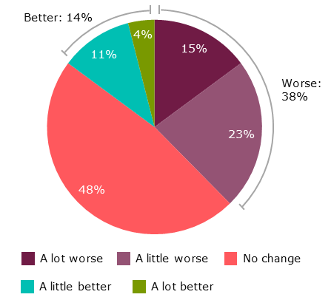
Covid-19 has impacted adults’ financial situations but has not affected the finances of all groups in society equally
Changes to overall financial situation
March to October 2020
Over a quarter (24%) of all employees were furloughed under the Government’s Coronavirus Job Retention Scheme for any length of time by October 2020
17% of employees had their hours or pay cut
7% of employees were made redundant or lost their job because their employer ceased trading
In October 2020, 2 in 5 adults reported that their overall financial situation had worsened due to the pandemic
Proportionately more were affected this way among:
  the self-employed
  low income households
  BAME adults
Figure ES.2: Impact of Covid‑19 on adults’ financial situation overall (Oct 2020)
Source: Covid‑19 survey, Oct 2020 Base: All UK adults (Oct 2020:22,267), excluding ‘ don’t know’ responses (3%) Question: F16 (Rebased). Thinking about your financial situation overall, to what extent have you been impacted by the Covid‑19 pandemic to date?

Slide 23
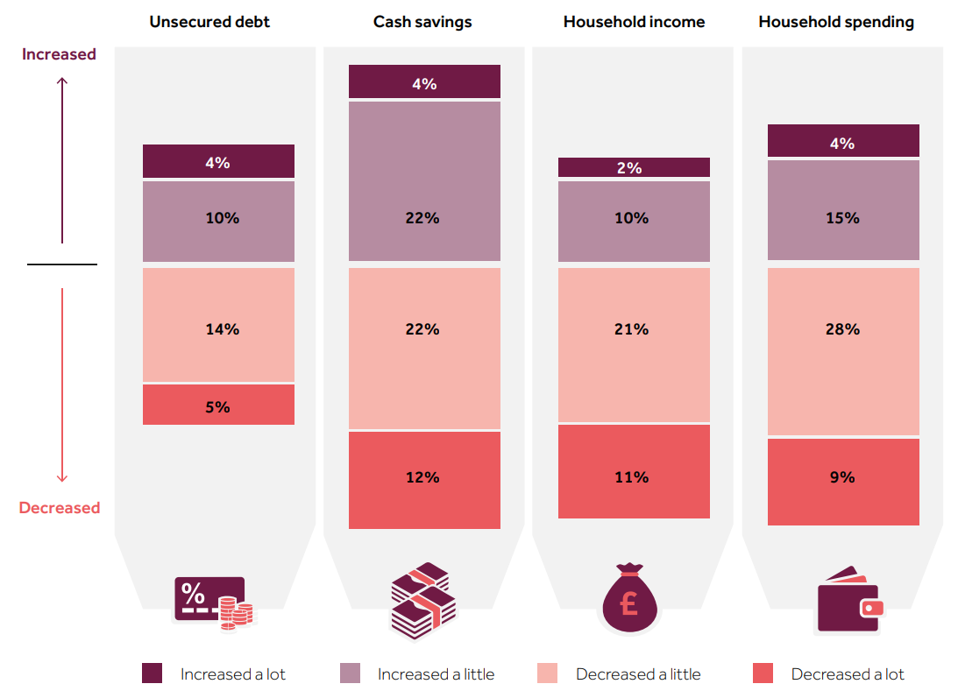
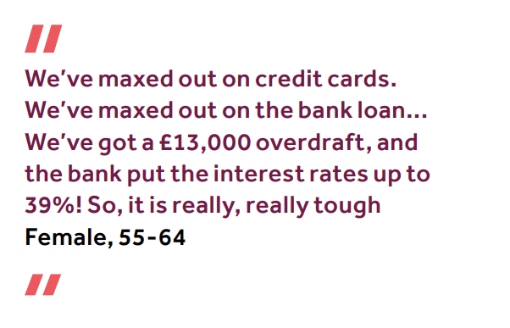
There have been positive and negative impacts of Covid-19 on debt, savings, income and spending
FCA Official
Negative impacts include 34% of adults reporting a decrease in cash savings, 33% reporting a decrease in household income, and 14% reporting an increase in unsecured debt.
Positive impacts include 12% experiencing an increase in household income, and 19% reducing their unsecured debt.
Source: Covid-19 survey, Oct 2020 Base: All UK adults (Oct 2020:22,267), excluding ‘don’t know’ responses (2%/1%/1%/1%). Question: F1 (Rebased)/F4 (Rebased)/F7 (Rebased)/F10 (Rebased). Comparing your … now and at the end of February. Overall, has your … increased, decreased or stayed the same? Note: The base for ‘cash savings’ is those with any cash savings at the end of February

Slide 24
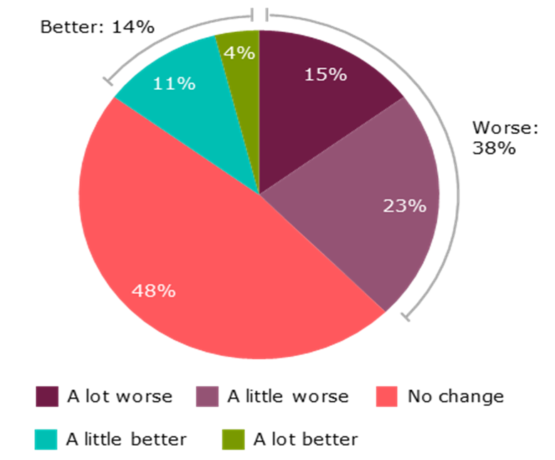

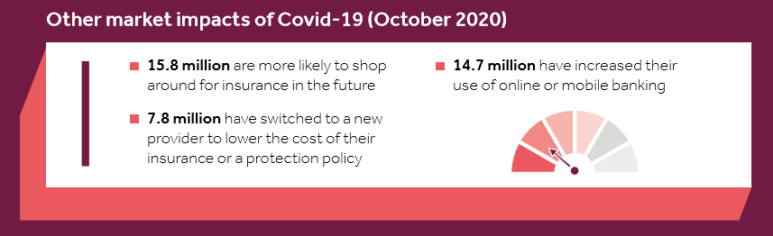
The positive financial impacts of Covid-19: who is better off?
14%
of UK adults found their overall financial situation to be better as a result of Covid-19
19%
of UK adults say their unsecured debt has decreased since February 2020
12%
of UK adults experienced an increase in household income

Slide 25
Between March and October 2020: 17% of mortgage holders and 19% of adults with any credit or loan product took a payment deferral – without these deferrals many more would have struggled
Extent to which payment deferrals helped mortgage borrowers (Oct 2020)
Extent to which payment deferrals helped credit and loan customers (Oct 2020)
Figure 4.14: Extent to which payment deferrals helped mortgage borrowers (Oct 2020)
Source: Covid‑19 survey, Oct 2020 Base: All UK adults who have taken a mortgage payment holiday because of Covid‑19 (Oct 2020:1,146) Question: PH2. How would you have coped financially, if you had not had a mortgage payment holiday?
Extent to which credit/loan deferrals helped mortgage borrowers (Oct 2020)
Source: Covid‑19 survey, Oct 2020 Base: All UK adults who have arranged a payment deferral for any type of credit or loan (excluding overdrafts) because of covid-19 (Oct 2020: 3,073) Question: PH15. how would you have coped financially, if you had not had a payment holiday(s) or ‘payment deferral(s)’ on your credit/ loan(s)?

Slide 26
How are consumers prioritising their bills in February 2020?
9% of UK adults have missed, or fallen behind on, domestic bills or credit commitments in one or more of the last 6 months
Which credit commitments and/ or domestic bills have you missed, or fallen behind on, in the last 6 months?
Which utility bills have you missed, or fallen behind on, in the last 6 months?
Summary of bills that consumers have to pay personally and the top 3 they would prioritise if they were unable to pay all their bills
Those that have fallen behind on domestic bills/ credit commitments in 3 or more months of the last 6 months, and those who say keeping up with domestic bills and credit commitments is a heavy burden, together make up the 14% of UK adults who are over-indebted
Source: FLS Feb 2020 Base: All UK adults (16,190); All UK adults that have fallen behind on or missed commitments… (Feb 2020:1336); All UK adults that have fallen behind on utility bills … (Feb 2020:557); Over-indebted (2,127)
Question: K33bcsum/K33/K33a Which credit commitments/ utility bills have you missed, or fallen behind on, in the last 6 months? Which of the following bills/ outgoings do you personally have to pay each month? If you were unable to pay all your bills/ outgoings, which three of the following three would you pay first?

Slide 28




A company response
Louise Beardmore
Customer Service and People Director

Slide 29
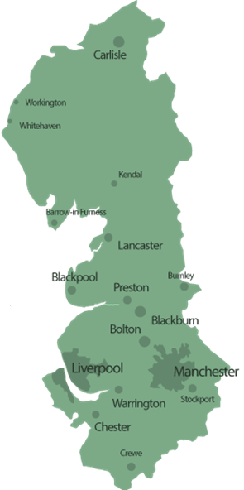
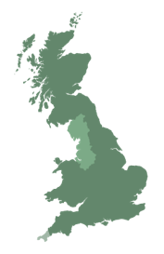
Who are the customers we serve?
Regional Levels of Deprivation
 | 1% most deprived | 5% most deprived | 10% most deprived | 20% most deprived
North West | 47% | 36% | 29% | 23%
East | 8% | 6% | 7% | 8%
North East | 13% | 10% | 10% | 9%
Midlands | 9% | 18% | 20% | 18%
South | 2% | 2% | 3% | 3%
Devon & Cornwall | 1% | 1% | 2% | 2%
South East | 0% | 1% | 3% | 9%
Bristol & Wessex | 0% | 0% | 0% | 0%
Yorkshire | 16% | 18% | 17% | 14%
We have a diverse customer population, serving 7 million customers in rural to inner city communities. The North West faces some specific affordability challenges.
207.000 claims to the SEISS scheme
431,900 people furloughed under CJRS
59 of the 100 most deprived neighbourhoods are in the North West.
More asylum seekers in the North West than any other region of the UK.
32% of North West households earn less than £21,000 per year
* Based on 2019 data
Unemployment rate is 5.3%
755,100 Universal Credit claimants in July
Covid magnified the issues we already faced
  Levels of poverty
  Heavy dependency on benefits
  Zero hour contracts and part time work
  Multi generation housing

Slide 30

The reality of what we faced
Illness, bereavement, financial loss and mental health our own employees are the customers we serve
Response has to be local not regional
Bolton to Wilmslow is only 8 miles but the impacts and differences extreme
Employees are also
impacted
Extreme in region variations
Greater focus from Customers but especially from employees on ‘purpose’ not just what we do but ‘how’ we do it
Rise of purpose
Working from home using more water – production requirements but also bill impacts
Greater water demand
Most water companies are taking part in Covid typing and tracing
Traceable but not transmittable
Increase in digital transactions
Acceleration in digital transactions as customers engaged multi channel as did the cyber community!
Technology, policy and process redesign
Changes to market arrangements
Regulatory and company support for Wholesaler credit relief to support the NHH retail market
Work at pace to enable change – performance and engagement has benefited as a result
Home working
Need for flexible affordability support
Quickly deployed technology and resources to home working – there is a practical reality of what can be done at home
Initial panic before furlough established

Slide 31






Customer focussed support
Targeted support
£71m of shareholder funds to support affordability enabling support to 200k customers
Extending our Priority Services offering
improving the quality and scale of the support we provide with customers and agencies
Forecast support scheme sign-up rates
Hardship Hub pivotal in enabling community support
Contains over 500 schemes from 300 organisations
Just Breath
As a result of Covid or transition to Universal Credit
Lowest bill guarantee
Our price promise for customers that could benefit from a water meter, but are worried that it might cost them more
Supporting communities
700k meals donated through remuneration donations to foodbanks in the North West

Slide 32

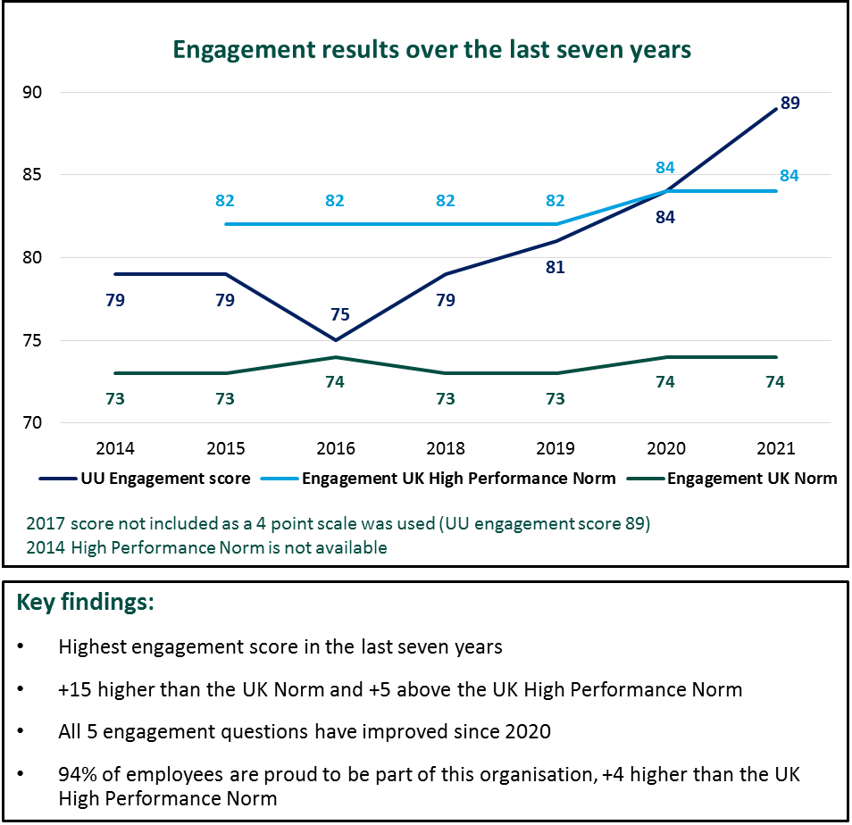

Employee focussed support
Top 20 glassdoor employer – 4.5/5
91% recommend to a friend
94% CEO approval
Extending our Priority Services offering
Forecast support scheme sign-up rates
Creation of Hardship Hub to support debt advisors
Contains over 500 schemes from 300 organisations
We are hear to help
Supporting our colleagues families
‘Lifeline when we didn’t know where to turn’
150 colleagues supported value of £350k
Key findings:
+15 higher than the UK Norm and +5 above the UK High Performance
94% of employees are proud to be part of the organisation

Slide 33
What now and what does that mean for the future?
Impact is still more extreme in specific regions
One size won’t fit all – targeted support and intervention
The focus needed on vulnerability and affordability was huge its now enormous!
Opportunity for greater collaboration across regulated industries
Markets will take time to recover and some may have changed for ever
Regulatory intervention and collaboration to support markets / sectors
Purpose, communities and partnerships matter
Behaviour has become established and it will take time
to shift
Timescales need to be realistic and evidence based
The opportunity to ‘build back better’ has to be the legacy of Covid
Green recovery, carbon, skills agenda, diversity and inclusion – what is driving the agenda?
Recognising, incentivising and rewarding ‘stewardship’
is a key opportunity to drive and embed change

Slide 34
Thank you

Slide 35
Attendees

